Slide 1
Data Structures 資料結構
Trees – Red-Black Trees
Department of Computer Science
National Tsing Hua University

Slide 2
Features (Rules) of Red-Black Trees
RB1. Every node is colored either red or black
RB2. The root node and leaf node (NIL) are black
RB3. Every red node has only black children
RB4. Every path from the root to a leaf contains the same number of black nodes
RBT is also a BST
If one node has only 1 or no children, then the other children is NIL
NIL is a black leaf node without value

Slide 3
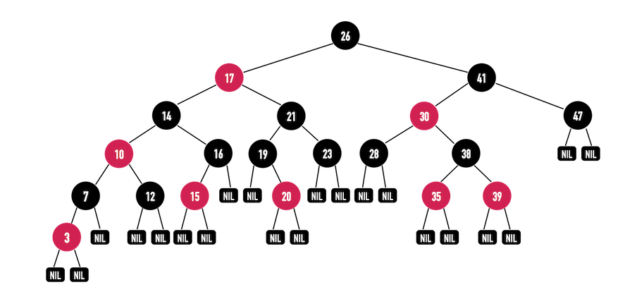
Example of Red Black Tree

Slide 4
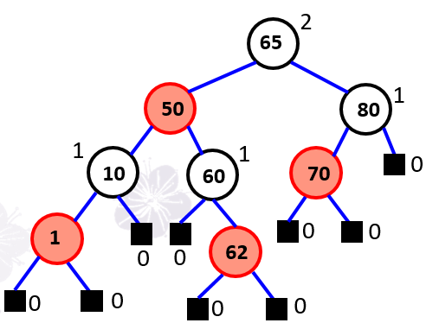
Rank - Black Height
The rank (black-height) of a node K in a red-black tree is the number of black nodes on any path to a leaf (NIL), not counting K.
The rank of each node in a red black tree

Slide 5
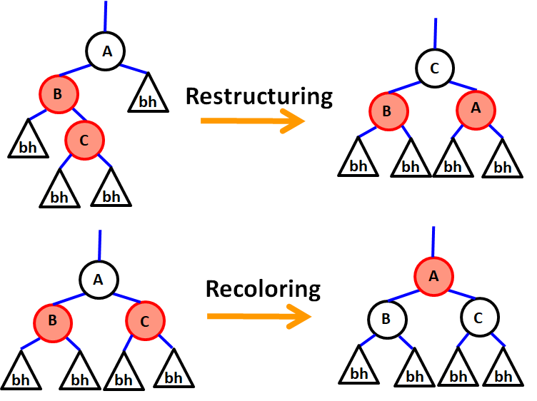
Adjustments of Red-Black Trees

Slide 6
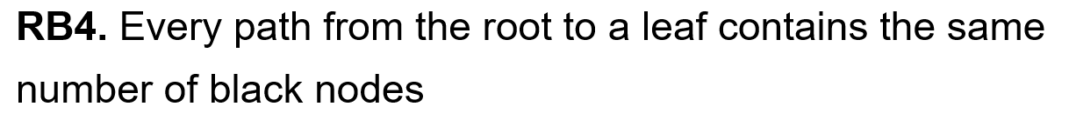
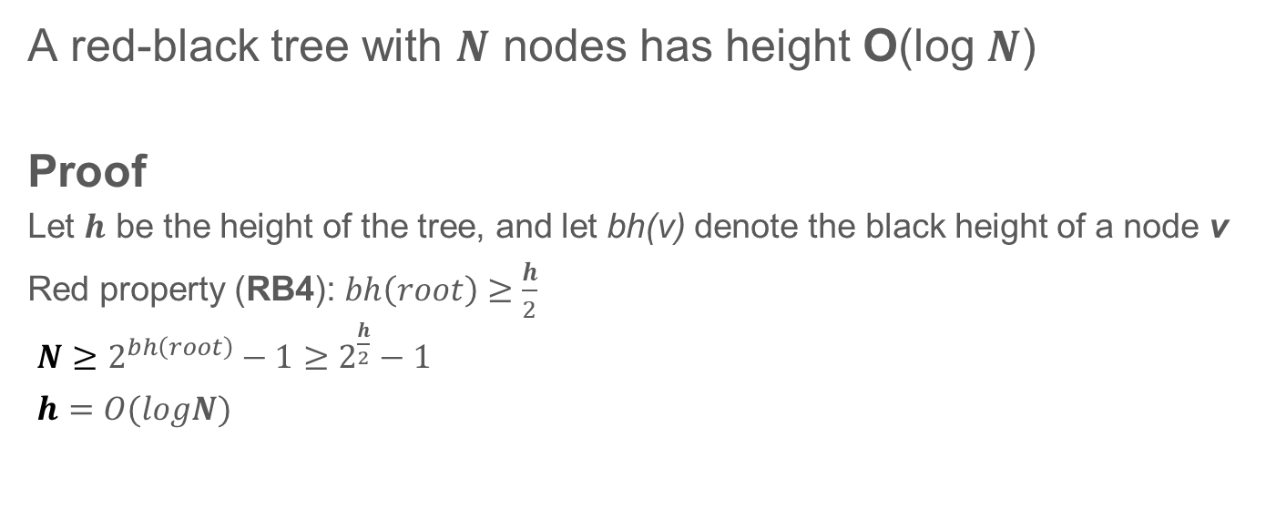
Height of a Red-Black Tree
A red-black tree with $N$ nodes has height O(log $N$)
Proof
Let $h$ be the height of the tree, and let bh(v) denote the black height of a node v
Red property (RB4): $bh\left(root\right)≥\frac{h}{2}$
$N≥2^{bh\left(root\right)}−1≥2^{\frac{h}{2}}−1$
$h=O(logN)$

Slide 7
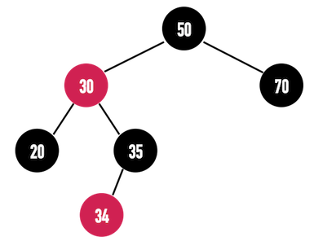
Insertion
The first half is the same as in BST
Difference:
The Inserted node is red
Need to deal with the part which violates RBT’s rule

Slide 8
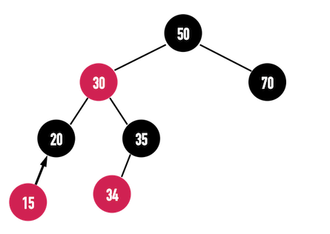
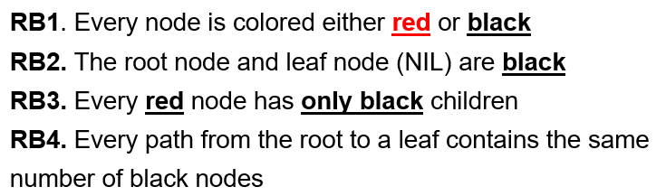
Insertion Example
If we insert a node 15 and it’s parent is black
It still satisfies RBT’s rule

Slide 9
Insertion Example
If we insert a node 15 and it’s parent is black
It still satisfies RBT’s rule
Question:
Why do we set the inserted node to be red?
Notes:
因為leaf的NIL是黑的，運氣好就不用recolor and restructing

Slide 10
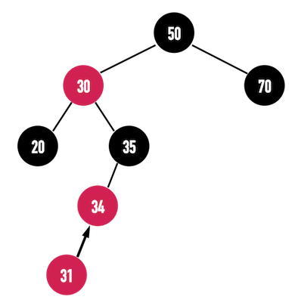
Insertion Example
If we insert a node 31 and it’s parent is red
Violating rule RB3
Need adjustment

Slide 11
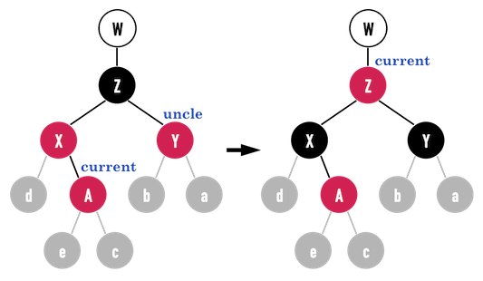
Insertion (Case 1) – Assuming A is red
If A’s parent X and uncle Y are red then
Color X, Y to black
Color their parient Z to red
If Z’s parent W is black then it’s done
Else If W is red then
move the current pointer to Z repeat the above process for the node pointed by current Note 1. When A is a left child, the same idea applies
Note 2. A is not necessarily the newly inserted node. A can be a red node during tree adjustment

Slide 12
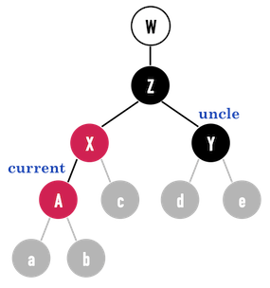
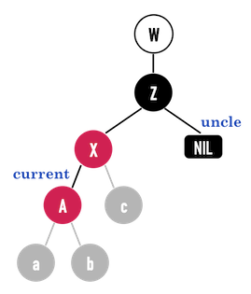
Insertion (Case 2)
If A is left child and A’s parent X is red and uncle Y is black
Moreover, if A is the node just inserted, according to RB4, “Every path from the root to a leaf contains the same number of black nodes”
uncle Y must be NIL

Slide 13
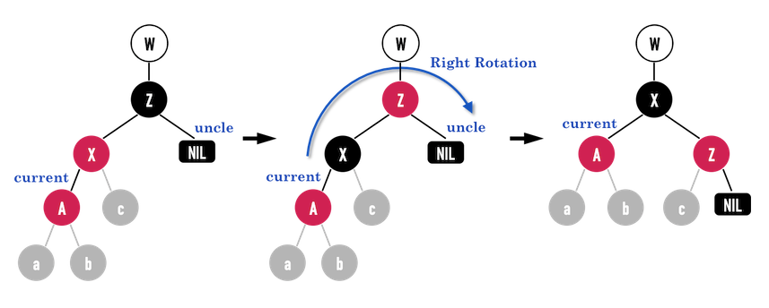
Insertion (Case 2)
If A is left child and A’s parent X is red and uncle Y is black then
Color A’s parent X to black
Color X’s parent Z to red
Do Right Rotation

Slide 14
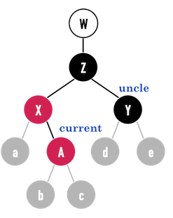
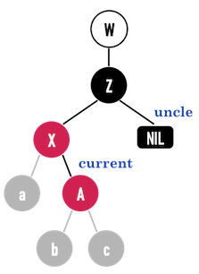
Insertion (Case 3)
If A is right child and A’s parent X is red and uncle Y is black
According to RB4, “Every path from the root to a leaf contains the same number of black nodes”
uncle Y must be NIL (similar to Case 2)

Slide 15
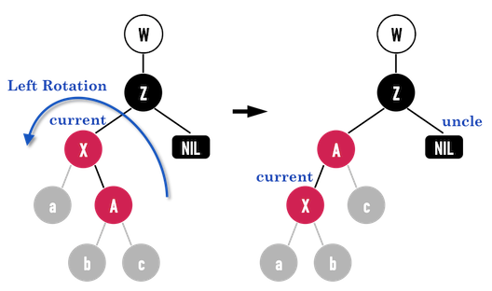
Insertion (Case 3)
If A is right child and A’s parent X is red and uncle Y is black then
Do Left Rotation to transform to Case 2
Apply Case 2

Slide 16
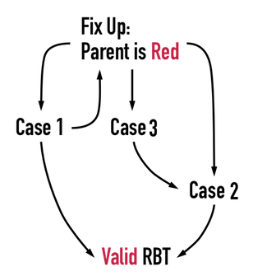
Insertion
Parent & uncle
Left child & Parent & uncle
right child & Parent & uncle

Slide 17
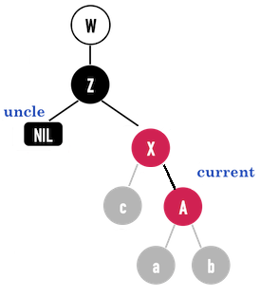
Insertion
All of the cases we mentioned discuss that the node’s parent is the node’s parent’s parent’s left child
If the tree looks like the tree at right, then
just change the rotate direction

Slide 18
Deletion
The first half is the same as in BST
To delete an element with key k
Search for the key k
If the search is successful then we delete it If the deleted node is red then we are done Else (black), we have to deal with three cases
–The element is a leaf node
–The element is a non-leaf node with one child
–The element is a non-leaf node with two children

Slide 19
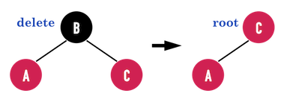
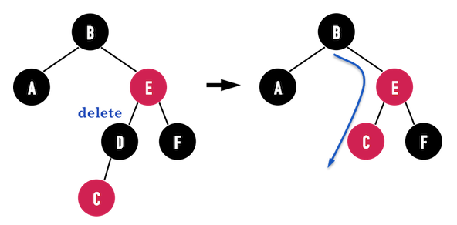
Deletion
The rule that may be violated after deletion:
(a) violates RB2 and RB3
(b) violates RB3 and RB4
(a)
(b)

Slide 20
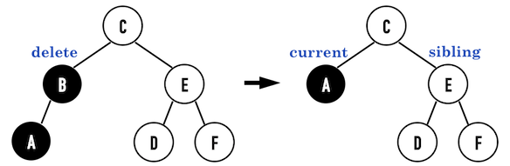
Deletion of a black node
Delete B, and B is black
It must violate RB4
White nodes may be black or red

Slide 21
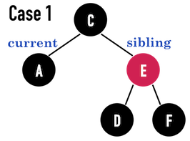
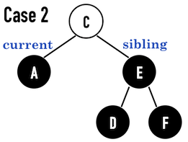
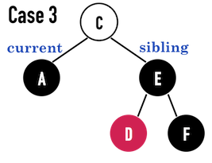
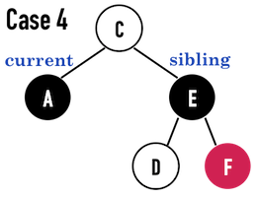
Deletion of a black node
Case1: sibling is red
Case2: sibling is black, and sibling’s two child are black
Case3: sibling is black, and sibling’s rightchild is black, leftchild is red
Case4: sibling is black, and sibling’s rightchild is red

Slide 22
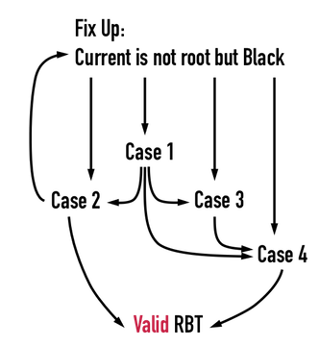
Deletion

Slide 23
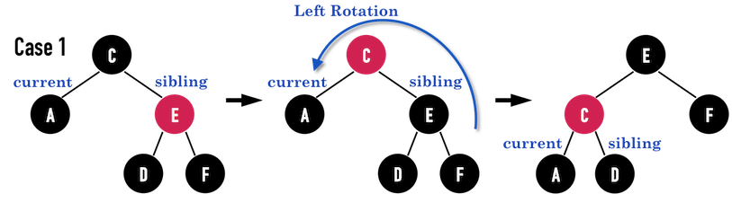
Deletion of a black node - Case1: sibling is red
Re-color
Rotate

Slide 24
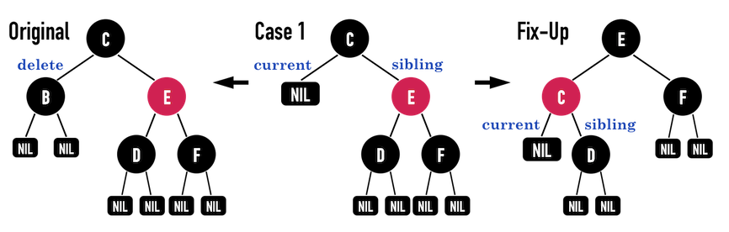
Deletion - Case1: sibling is red
Why we are not done yet?
The RBT before deleting node B like (a), each path from root to leaf is 3-black-nodes, but after deleting node B and fixed up like (c), it has a 2-black-nodes path
(a) (b) (c)

Slide 25
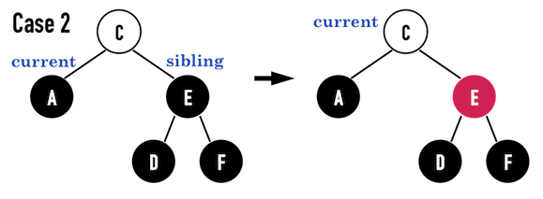
Deletion - Case2: sibling is black, sibling’s two childs are black

Slide 26
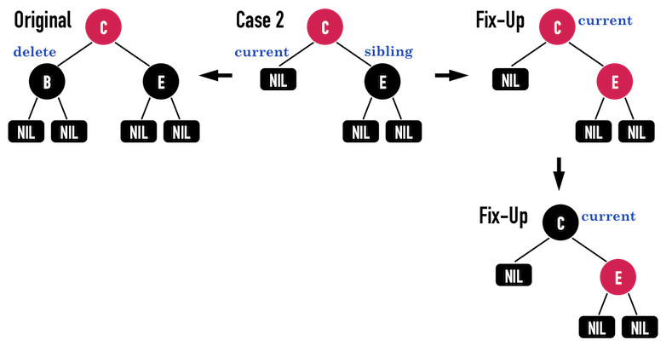
Deletion - Case2: sibling is black, sibling’s two child are black
If the parent of the deleted node (called P hereafter) is red
Re-color
Move current to P

Slide 27
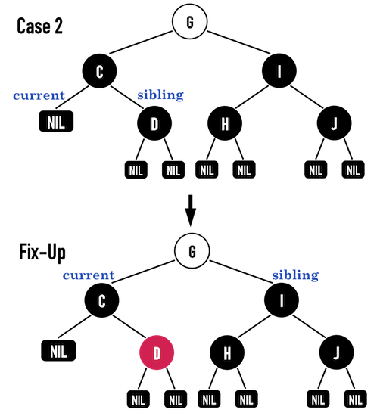
Deletion - Case2: sibling is black, sibling’s two child are black
If P is black and non-root
Re-color
Move current to P’s parent and
keep checking

Slide 28
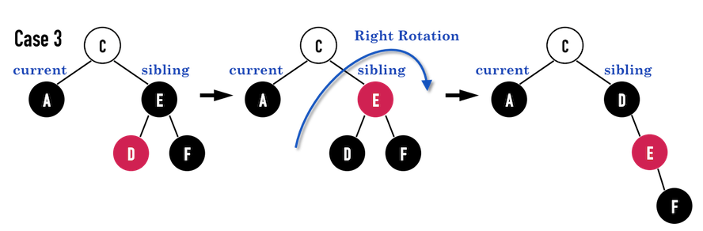
Deletion - Case3: sibling is black, sibling’s rightchild is black, leftchild is red
Continue to Case 4
Re-color
Rotate

Slide 29
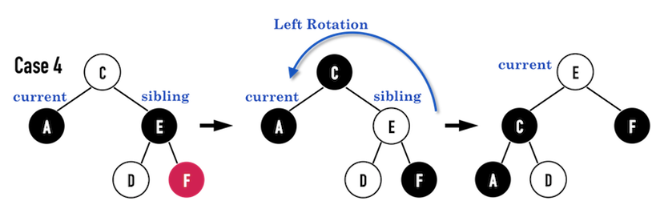
Deletion - Case4: sibling is black, sibling’s rightchild is red
Re-color + Rotate
Move current to P

Slide 30
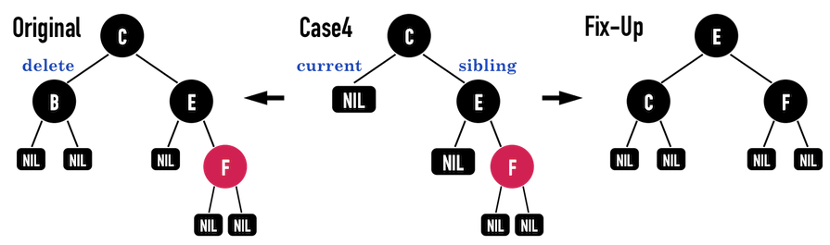
Deletion - Case4: sibling is black, sibling’s rightchild is red
The logic of Case 4 is to adjust the RBT (after deleting node B), make the number of black nodes of each path from root to leaf the same as the original RBT. So after Case 4’s fix up, new RBT satisfies the rules

Slide 31
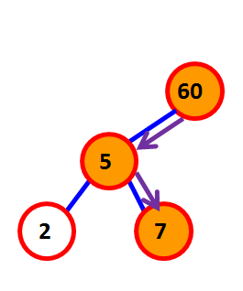
Search
RBT’s search is same as BST’s search
Search for key 7
Start from root
Compare the key with root
‘<’ search the left subtree
‘>’ search the right subtree
Repeat step 3 until the key is found or a leaf is visited

Slide 32
Red Black Tree summary
Time Complexity (N = # values stored in tree)
Insertion O(log N)
Deletion O(log N)
Search O(log N)

Slide 33
Comparison
Tree Type | Height | Insert/Delete | Search
AVL | WIN | LOSE | WIN
Red Black | LOSE | WIN | LOSE
Problem 1
#searches >> #insertions and #deletions=0 ?
AVL trees are faster
Problem 2
#insertions=#deletions and #searches=0 ?
Red-black trees are faster

Slide 34
Appendix
B tree(insert): http://btechsmartclass.com/DS/U5_T3.html
B tree(delete): http://www.voidcn.com/article/p-dfmcibek-bbt.html
2-3 & 2-3-4 tree: www.cse.iitd.ac.in/~mohanty/col106/Resources/234-Trees.pptx
2-3-4 tree(有動畫過程可參考):
https://www.educative.io/page/5689413791121408/80001
Red black tree: http://alrightchiu.github.io/SecondRound/red-black-tree-introjian-jie.html

